Slide 1
Efficient Numerical Methods for Calculating Vibrational Spectra Based on the Hierarchical Equations of Motion Formalism
2022/5/13
D3 Hideaki Takahashi
Notes:
このようなタイトルで発表～

Slide 2
Today’s topic
Introduction of numerical methods ・Truncated PSD ・Signal estimation method based on ESPRIT algorithm ・Collocation method
Vibrational spectroscopies for liquid water

Slide 3
Today’s topic
Introduction of numerical methods ・Truncated PSD ・Signal estimation method based on ESPRIT algorithm ・Collocation method
Vibrational spectroscopies for liquid water

Slide 4
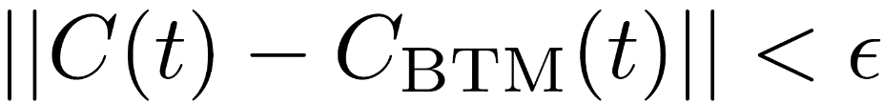
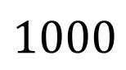
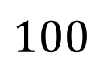
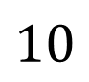

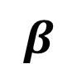
Truncated PSD (TPSD)
Spectral decomposition scheme for distribution function $n(ω,β)$
High temp approx
MSD/PSD
TPSD
FSD
$$β$$
$$1$$
$$10$$
$$100$$
$$1000$$
Procedure
1. Calculate BCF $C(t)$ based on ordinary PSD with a sufficiently large number of LTC terms
2. Find another exponential sum with a smaller number of terms using balanced truncation method (BTM)*, such that
*T. Peter, D. Potts, and M. Tasche, SIAM J. Sci. Comput. 33, 1920 (2011).

Slide 5
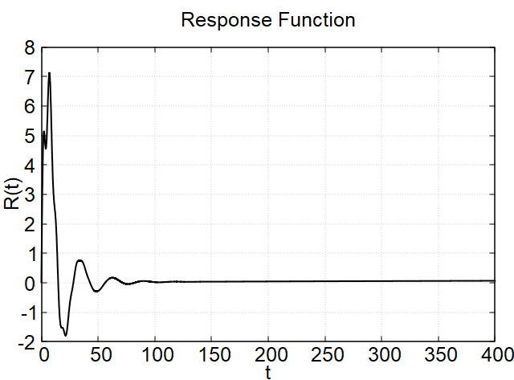
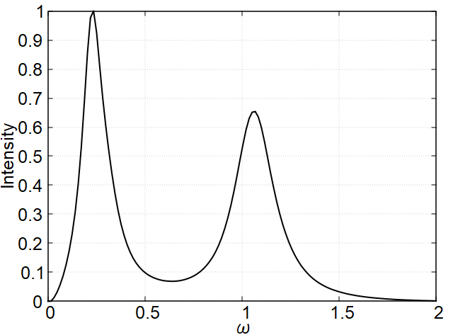
Signal estimation method based on ESPRIT algorithm
ex.) 1st order response
Response function
Spectrum
DFT
almost no information
⇒ estimate long-time behavior from short time signal
R. Roy and T. Kailath, IEEE Trans. Acoust. Speech Signal Process. 37, 984 (1989).

Slide 6
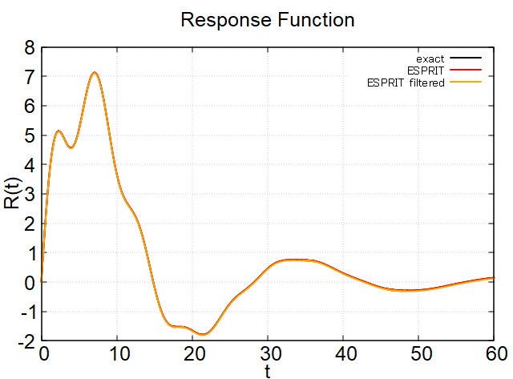
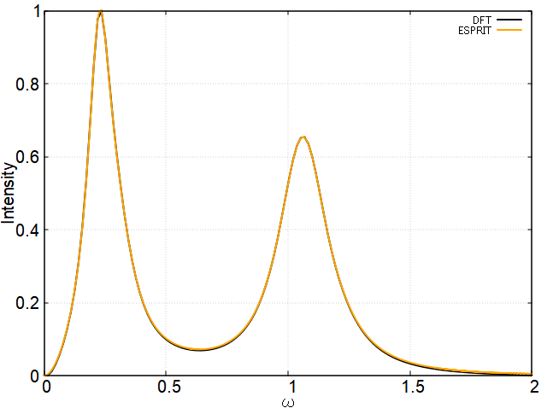
Signal estimation method based on ESPRIT algorithm
ex.) 1st order response
Response function
Spectrum
cf.)
R. Roy and T. Kailath, IEEE Trans. Acoust. Speech Signal Process. 37, 984 (1989).

Slide 7
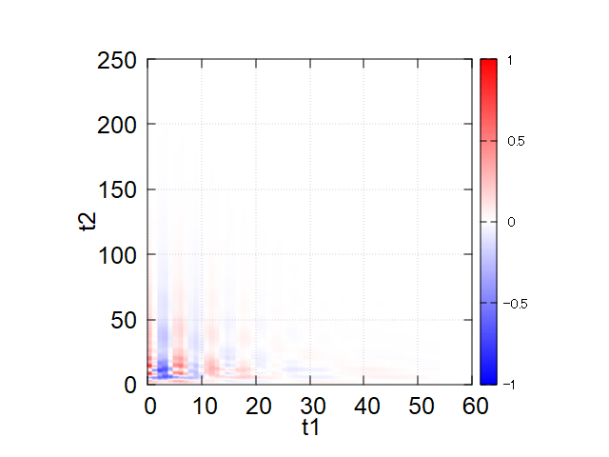
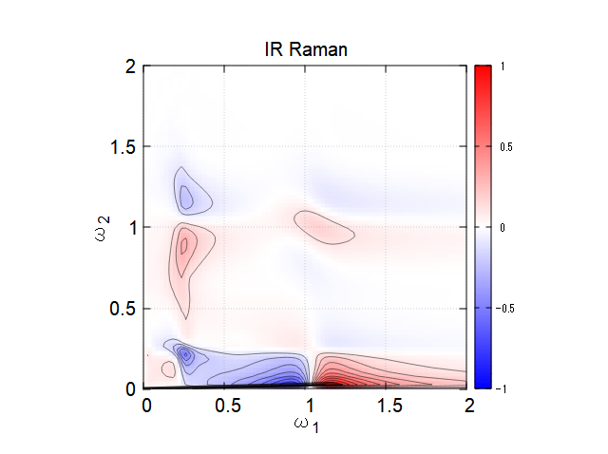
Signal estimation method based on ESPRIT algorithm
ex.) 2nd order response
Calculation time: 50 min (two mode, classical, intermediate coupling)
Response function
Spectrum
FT
DFT
ESPRIT
R. Roy and T. Kailath, IEEE Trans. Acoust. Speech Signal Process. 37, 984 (1989).

Slide 8

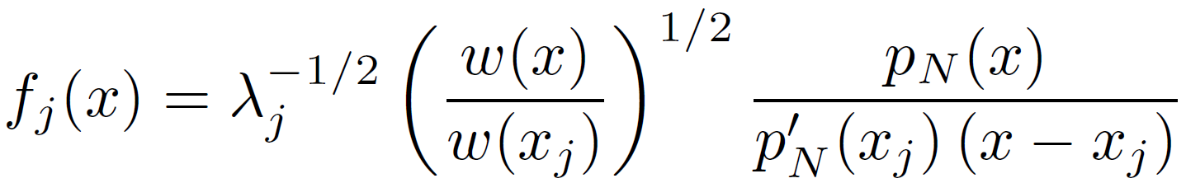
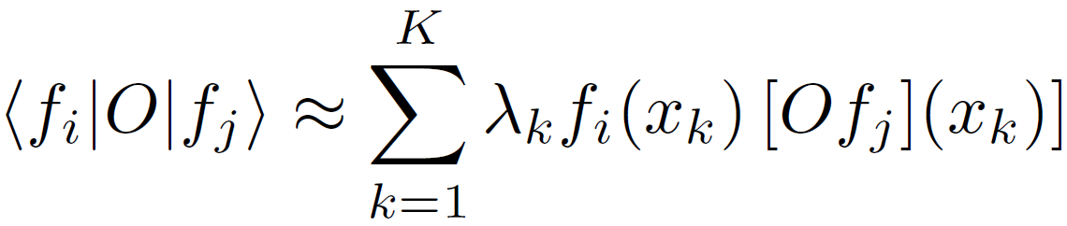
Collocation method
the discrete variable representation (DVR)
J.V. Lill, G.A. Parker, and J.C. Light, Chem. Phys. Lett. 89, 483 (1982).
Lagrange-mesh method (LMM)
D. Baye and P.-H. Heenen, J. Phys. A 19, 2041 (1986).
the quadrature discretization method (QDM)
B. D. Shizgal and H. Chen, J. Chem. Phys. 107, 8051 (1997).
Basis function
・More accurate than FDM
・Less mesh points needed
Gauss-quadrature approximation (exact in some cases)

Slide 9
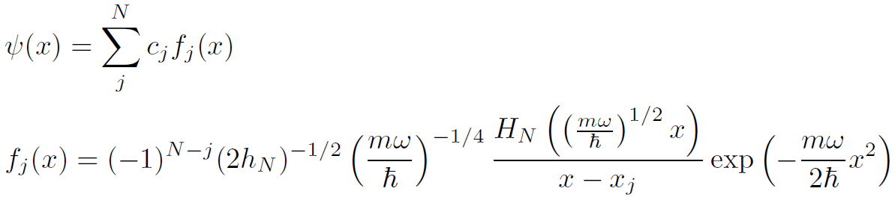
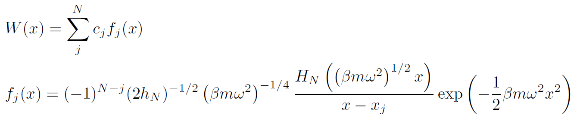
Collocation method
Application to oscillator systems
・Schrödinger equation
Wave function
Basis function
・Smoluchowski equation
Distribution function
Basis function

Slide 10
Today’s topic
Introduction of numerical methods ・Truncated PSD ・Signal estimation method based on ESPRIT algorithm ・Collocation method
Vibrational spectroscopies for liquid water

Slide 11
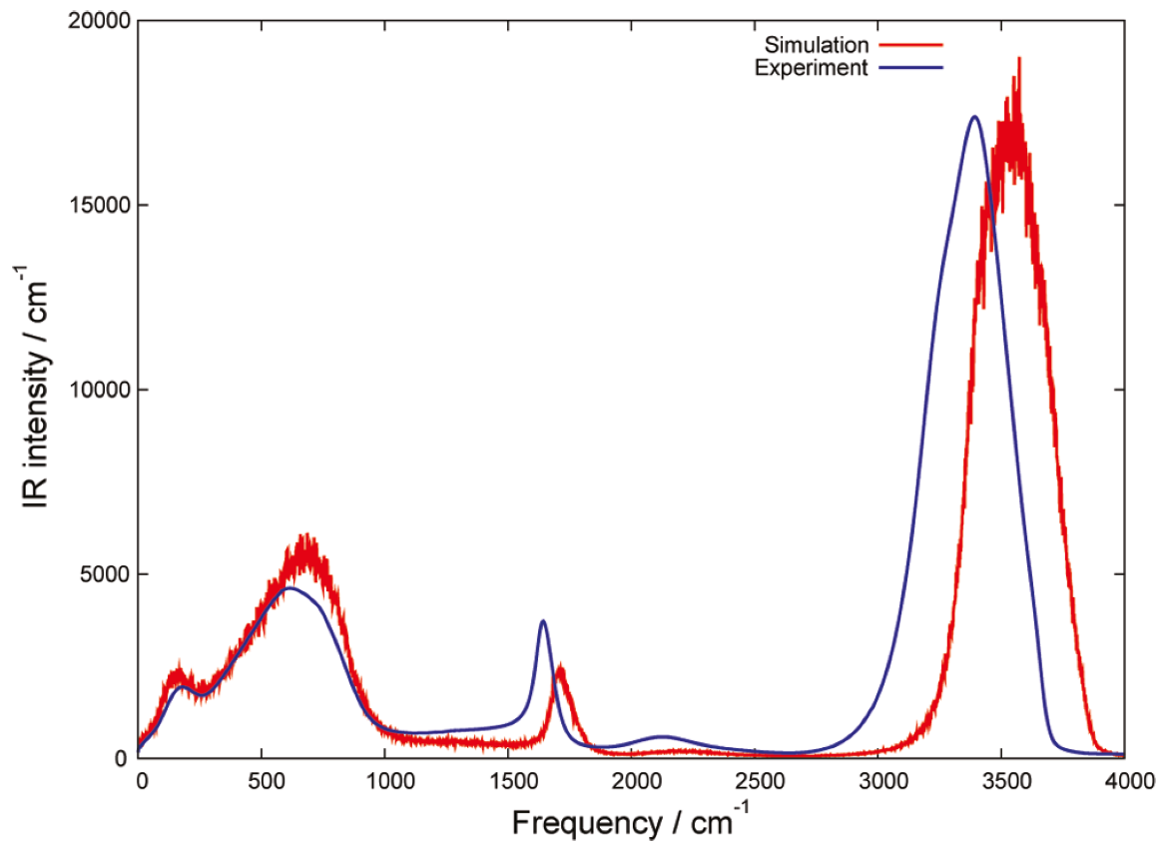
Intramolecular and intermolecular vibrational modes of liquid water
IR spectrum of liquid water
Vibrational modes
① OH stretch
② OH bend
③ Libration
④ HB translation
①
intramolecular
③
intermolecular
②
④
T. Hasegawa and Y. Tanimura, J. Phys. Chem. B 115, 5545 (2011).

Slide 12
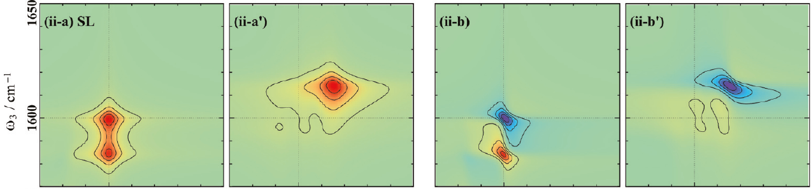
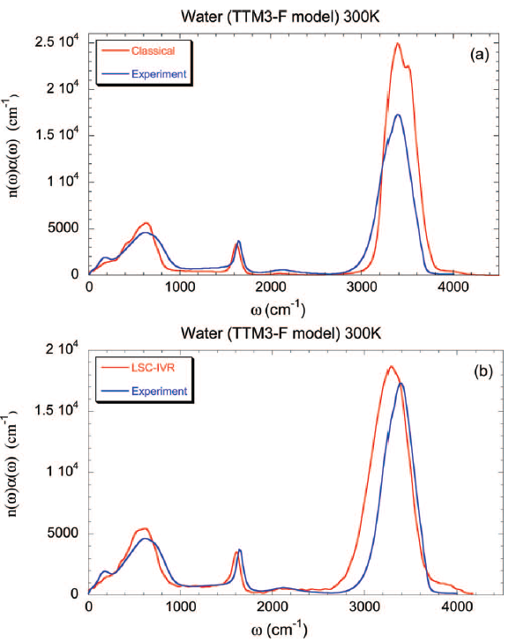
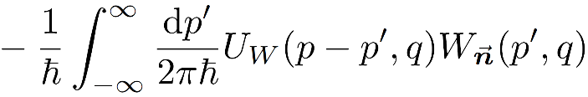
Theoretical problem in vibrational spectroscopies for water
q
c
Quantum effects (S-B model)
A. Sakurai and Y. Tanimura, J. Phys. Chem. A 115, 4009 (2011).
1) Nonlocality of potential
2) Non-Markovian noise
J. Liu, W. H. Miller, G. S. Fanourgakis, S. S. Xantheas, S. Imoto, and S. Saito, J. Chem. Phys. 135, 244503 (2011).

Slide 13
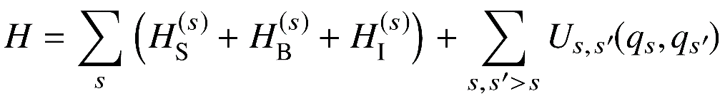
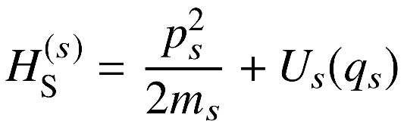
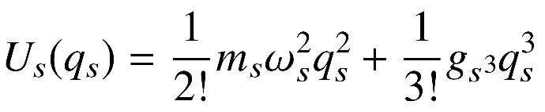
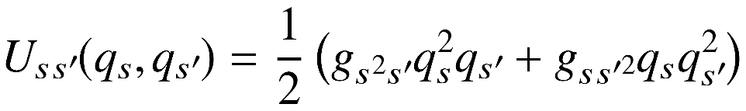
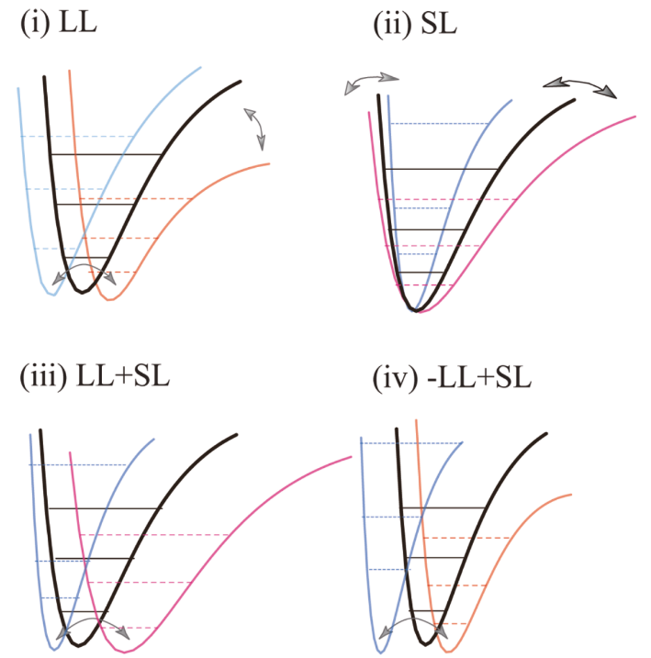
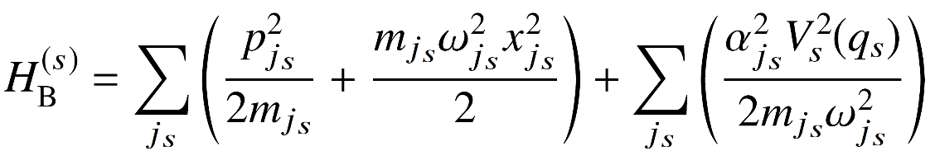
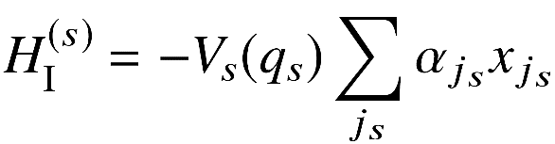
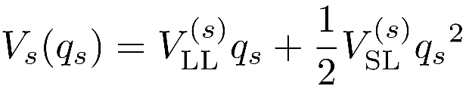
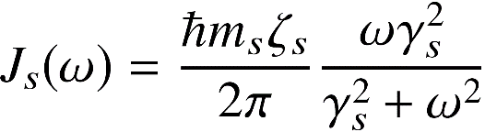
Model Hamiltonian
Total Hamiltonian
Hamiltonian of each mode
potential
Coupling between modes
Bath Hamitonian
System-bath coupling
Spectral density
A. Sakurai and Y. Tanimura, J. Phys. Chem. A 115, 4009 (2011).

Slide 14
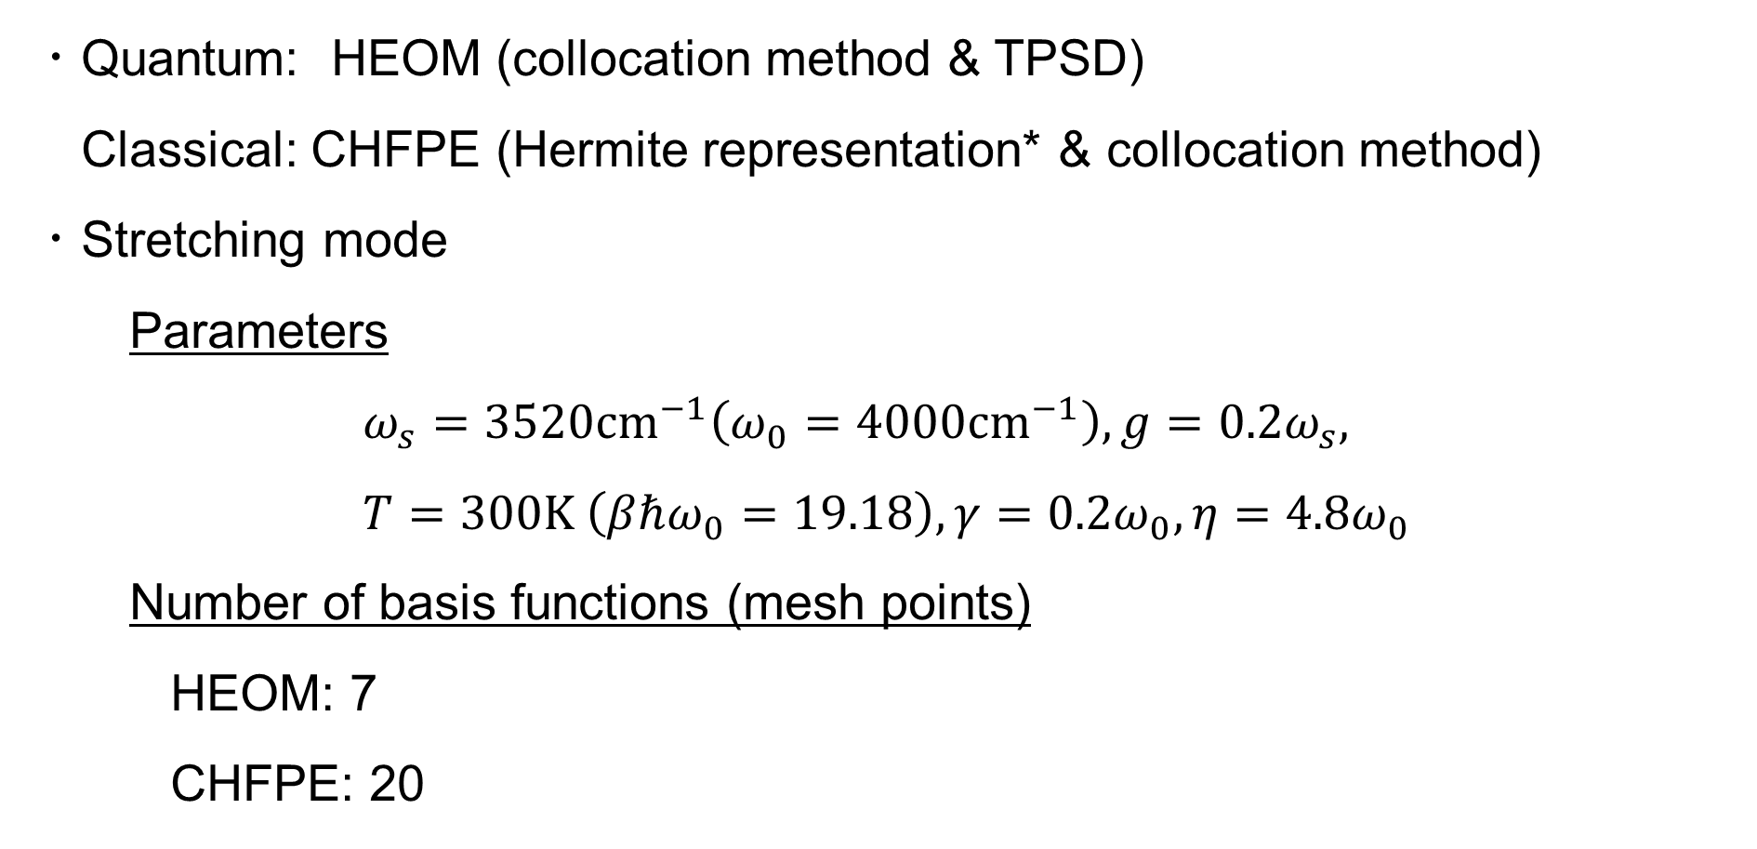
Simulation details
・Quantum: HEOM (collocation method & TPSD)
Classical: CHFPE (Hermite representation* & collocation method)
・Stretching mode Parameters
$$ω_{s}=3520cm^{−1}\left(ω_{0}=4000cm^{−1}\right), g=0.2ω_{s}, \\ T=300K \left(βℏω_{0}=19.18\right),γ=0.2ω_{0},η={4.8ω}_{0}$$
Number of basis functions (mesh points)
HEOM: 7
CHFPE: 20
*T. Ikeda, H. Ito, and Y. Tanimura, J. Chem. Phys. 142, 212421 (2015).

Slide 15
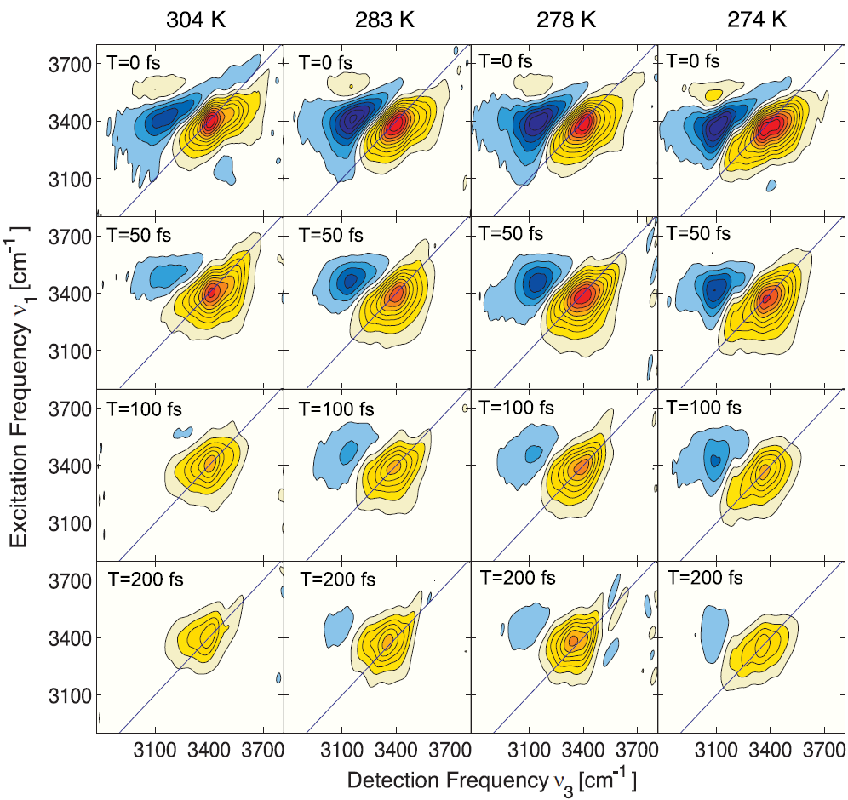
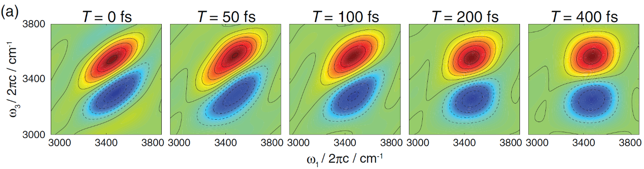
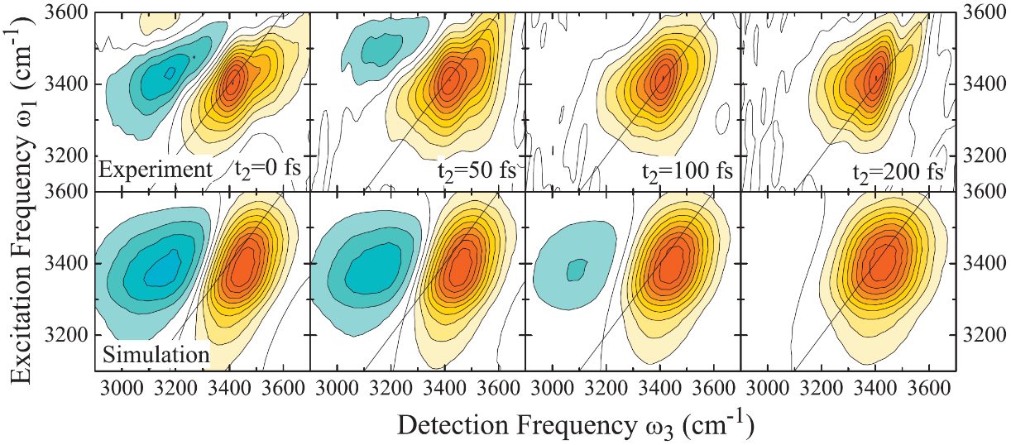
Review of 2D-IR spectra of neat water (stretch)
Experiment
Theory
・(ab intio-based) MD simulation
S. Imoto, S. S. Xantheas, and S. Saito, J. Chem. Phys. 139, 044503 (2013).
・Numerical integration of the Schrödinger equation (NISE)
D. Kraemer, M. L. Cowan, A. Paarmann, N. Huse, E. T. J. Nibbering, T. Elsaesser, and R. J. D. Miller, Proc. Natl. Acad. Sci. U.S.A. 105, 437 (2008).
A. Paarmann, T. Hayashi, S. Mukamel, and R. J. D. Miller, J. Chem. Phys. 130, 204110 (2009).

Slide 16
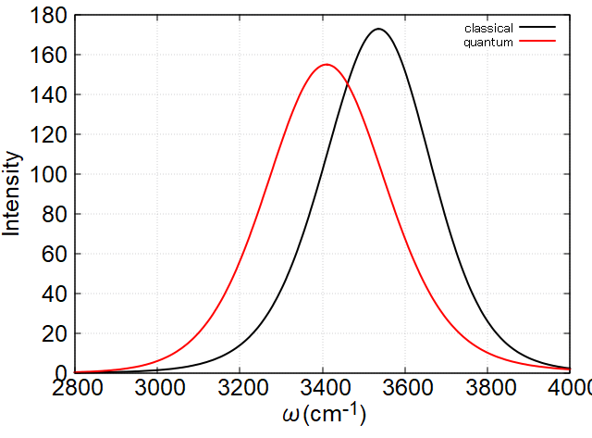

Result (IR spectrum)
T. Hasegawa and Y. Tanimura, J. Phys. Chem. B 115, 5545 (2011).
*Fit the quantum result to the experimental data
J. E. Bertie and Z. D. Lan, Appl. Spectrosc. 50, 1047 (1996).

Slide 17
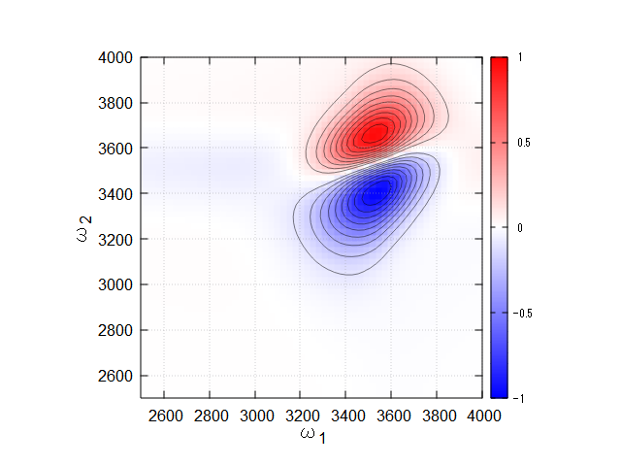
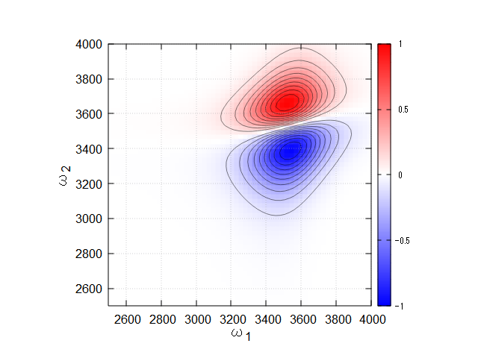
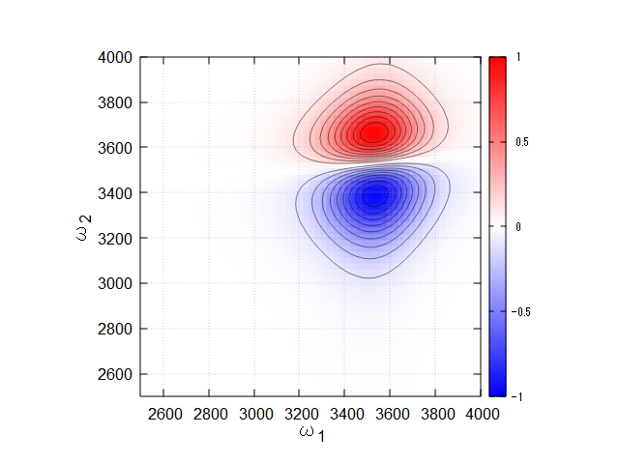

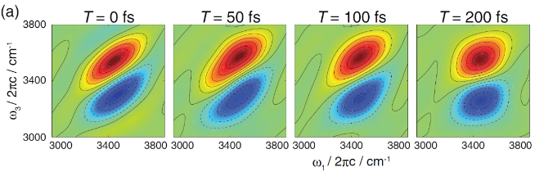
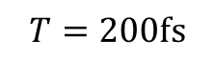
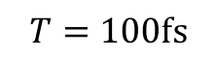
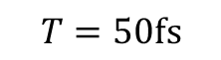
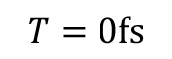
Result (Classical)
$$T=0fs$$
$$T=50fs$$
D. Kraemer, M. L. Cowan, A. Paarmann, N. Huse, E. T. J. Nibbering, T. Elsaesser, and R. J. D. Miller, Proc. Natl. Acad. Sci. U.S.A. 105, 437 (2008).
$$T=100fs$$
$$T=200fs$$
S. Imoto, S. S. Xantheas, and S. Saito, J. Chem. Phys. 139, 044503 (2013).

Slide 18
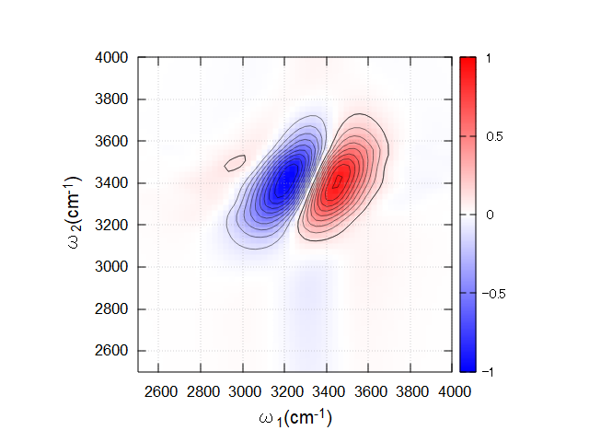
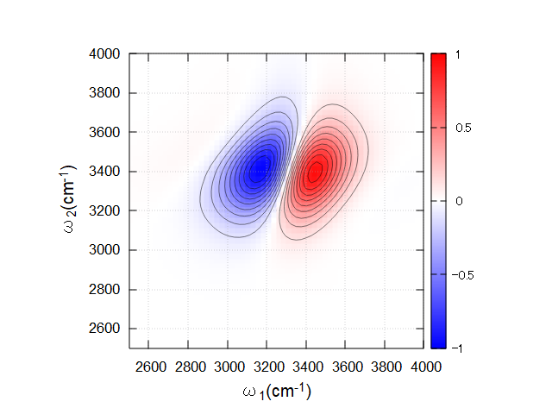
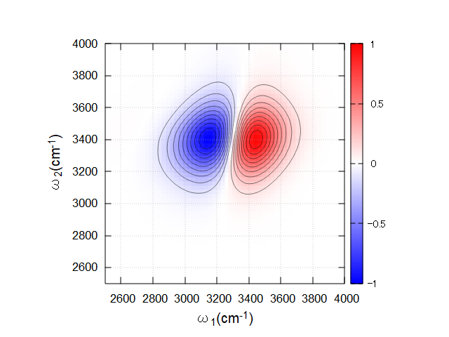
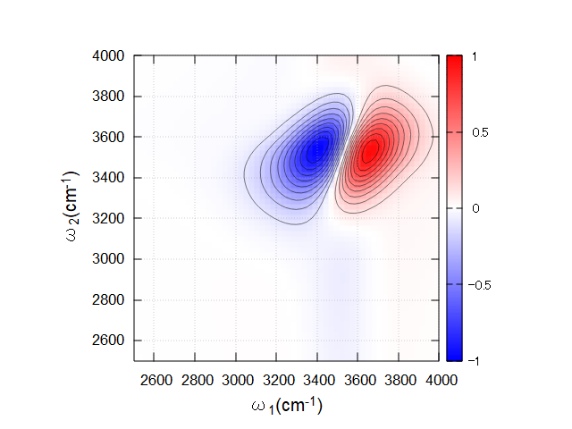
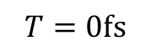
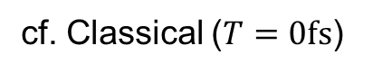
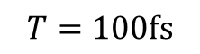
Result (Quantum)
$$T=0fs$$
$$T=50fs$$
$$T=100fs$$
cf. Classical ($T=0fs$)
Lacking fast vibrational dephasing induced by librational motion
⇒ more complex spectral density?
D. Kraemer, M. L. Cowan, A. Paarmann, N. Huse, E. T. J. Nibbering, T. Elsaesser, and R. J. D. Miller, Proc. Natl. Acad. Sci. U.S.A. 105, 437 (2008).

Slide 19
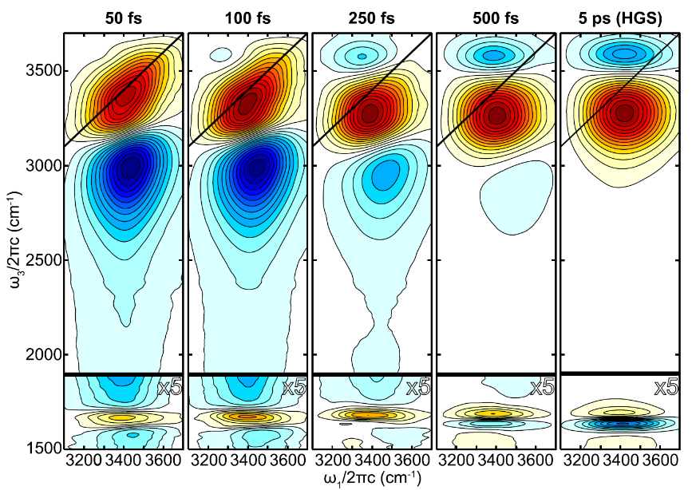
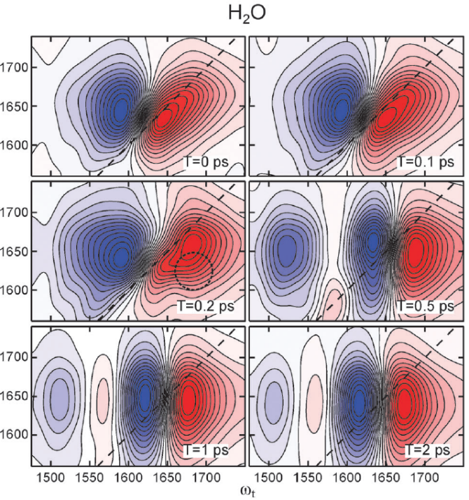
Summary
・Some numerical methods for model calculation of vibrational spectroscopies
・2D-IR spectra for stretching mode of neat water ・Quantum effects in high-frequency stretching mode
・Future work ・Fast dephasing in 2D-IR spectra ・Broadband 2D-IR spectra for stretching mode ・2D-IR spectra for bending mode ・Intermolecular modes with strong system-bath coupling
L. De Marco, J. A. Fournier, M. Thämer, W. Carpenter,
and A. Tokmakoff, J. Chem. Phys. 145, 094501 (2016).
L. Chuntonov, R. Kumarb and D. G. Kuroda, Phys.Chem.Chem.Phys. 16, 13172 (2014).

Slide 20









2D-Raman-THz
M. Cho, J. Chem. Phys. 111, 4140 (1999).
P. Hamm and J. Savolainen, J. Chem. Phys. 136, 094516 (2012).
2D Spectroscopies in the low-frequency range
・2D-Raman ⇒ Cascading problem
・2D-THz ⇒ Low pulse energy
D. A. Blank et. al., J. Chem. Phys. 113, 771 (2000).
W. Kuehn et. al., Phys. Rev. Lett 107, 067401 (2011).
・2D-Raman-THz
Circumvent these problems
D. A. Blank et. al., J. Chem. Phys. 111, 3105 (1999).
J. Savolainen et. al., Proc. Natl. Acad. Sci. U. S. A. 110, 20402 (2013).

Slide 21
2D-Raman-IR
M. Cho, J. Chem. Phys. 111, 4140 (1999).
P. Hamm and J. Savolainen, J. Chem. Phys. 136, 094516 (2012).
H. Ito and Y. Tanimura, J. Chem. Phys. 144, 074201 (2016).
Investigate a coupling between inter- and intra-molecular vibrational modes
Raman pulse + IR pulse (cf. 2D-Raman-THz)
⇒ cover a wide range of frequencies
Two-dimensional spectroscopies of vibrational modes
2D-Raman-IR
2D-Raman-THz
2D-IR
Intramolecular modes
wavenumber
Intermolecular modes

Slide 22









2D-Raman-IR
M. Cho, J. Chem. Phys. 111, 4140 (1999).
P. Hamm and J. Savolainen, J. Chem. Phys. 136, 094516 (2012).
H. Ito and Y. Tanimura, J. Chem. Phys. 144, 074201 (2016).
ex) Raman-IR-IR
cf. 2D-IR
⇒ Nonlinearity (NL) and Anharmonicity (AH) contribute to spectral peaks
Dipole
Polarization
Potential
Nonlinearity
Nonlinearity
Anharmonicity

Slide 23






2D-Raman-IR
M. Cho, J. Chem. Phys. 111, 4140 (1999).
P. Hamm and J. Savolainen, J. Chem. Phys. 136, 094516 (2012).
H. Ito and Y. Tanimura, J. Chem. Phys. 144, 074201 (2016).
(a) Raman-IR-IR
(b) IR-Raman-IR
(c) IR-IR-Raman
Response Function
Spectrum
2D-sine-FT

Slide 24



Filtering truncation scheme (FTS)
R. Hartle, G. Cohen, D. R. Reichman, and A. J. Millis, Phys. Rev. B 88, 235426 (2013).
R. Hartle, G. Cohen, D. R. Reichman, and A. J. Millis, Phys. Rev. B 92, 085430 (2015).
Scaled ADOs
Norm
Truncate scaledADOs that satisfy

Slide 25


Origin of anharmonicity
① Anharmonicity of a single mode
② Anharmonicity caused by coupling between modes
$$g_{s}=0.01,g_{b}=0.01$$
$$g_{sb}=0.01,g_{bs}=0.01$$
⇒ Difficult to distinguish from IR spectrum and also ordinary 2DIR spectroscopy

Slide 26
Difficulty in intermolecular modes
・System-bath coupling is extremely strong ⇒ another treatment is necessary
・Collective bath coordinate mapping formalism (Ikeda2022)

Slide 27


Broadband 2D-IR spectroscopy
probe
pump
*Pulse duration: 70fs
K. Ramasesha, L. De Marco, A. Mandal,
and A. Tokmakoff, Nat. Chem. 5, 935 (2013).
L. De Marco, J. A. Fournier, M. Thämer, W. Carpenter,
and A. Tokmakoff, J. Chem. Phys. 145, 094501 (2016).
⇒ suggeting the strong coupling between stretch and bend

